Slide 1

Project On HOTEL ROOM MANAGEMENT SYSTEM

Slide 2
INTRODUCTION
This system is basically related to hotel management.
We can add , modify , view data(rooms).
We can also check whether a room is vacant or booked.

Slide 3
Flow of system
Hotel room MANAGEMENT system:
Reservation
Cancellation
Display status
Modifying Records

Slide 4
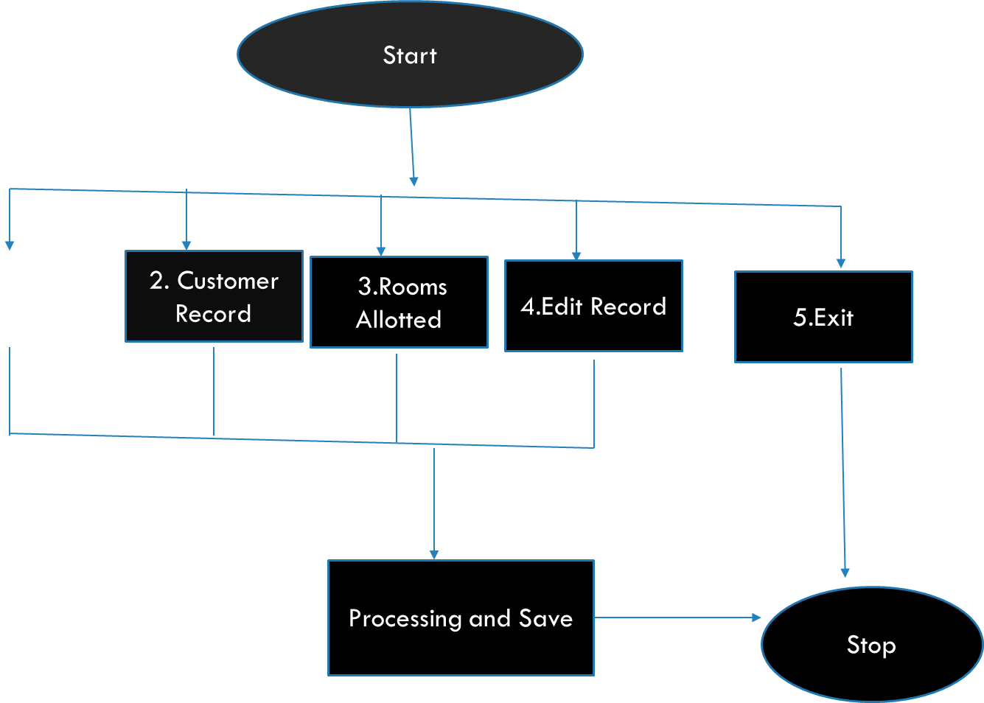

Slide 5
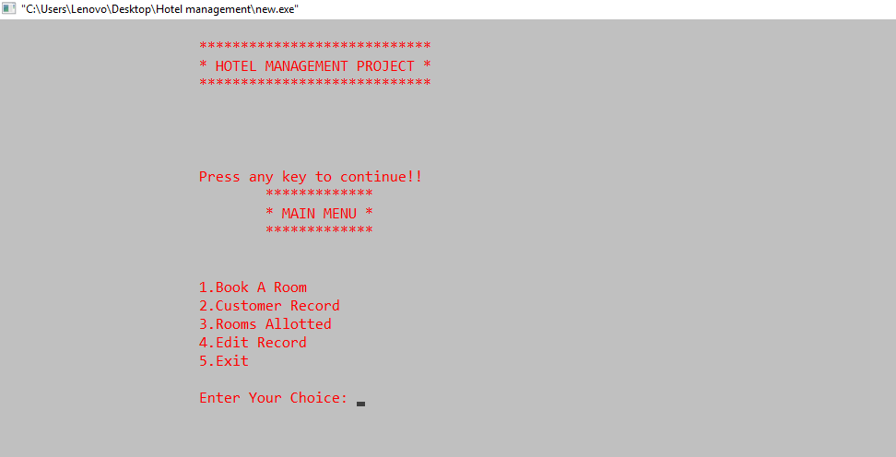
OUTPUT

Slide 6
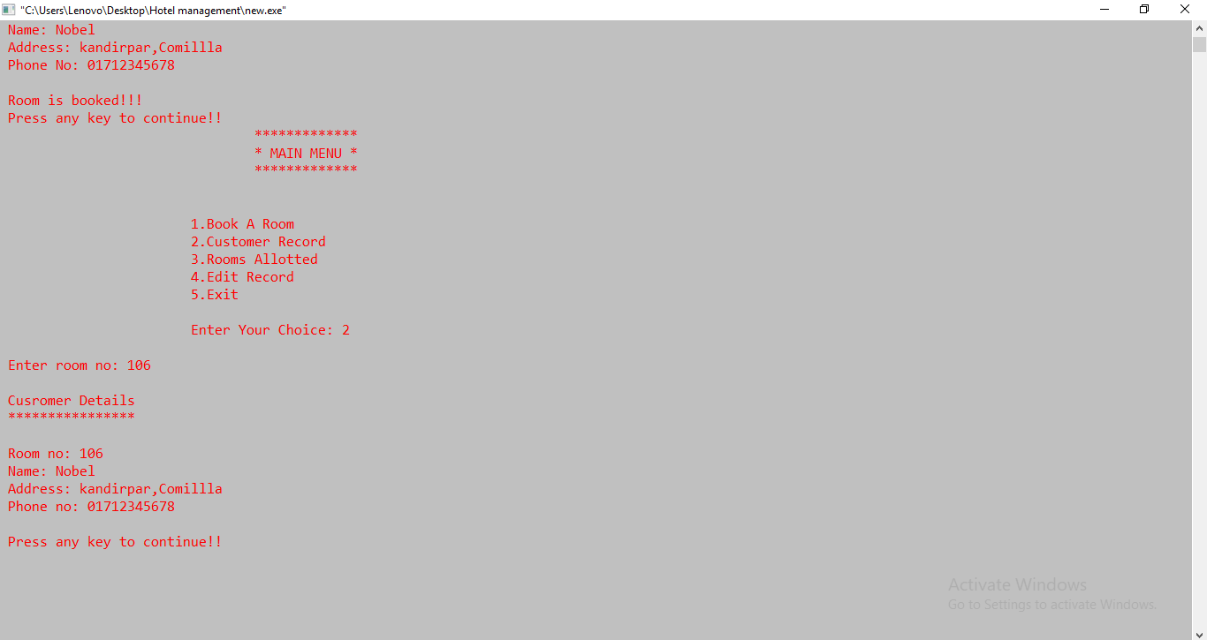
1.BOOKING 2.VIEWING CUSTOMER RECORDS:

Slide 7
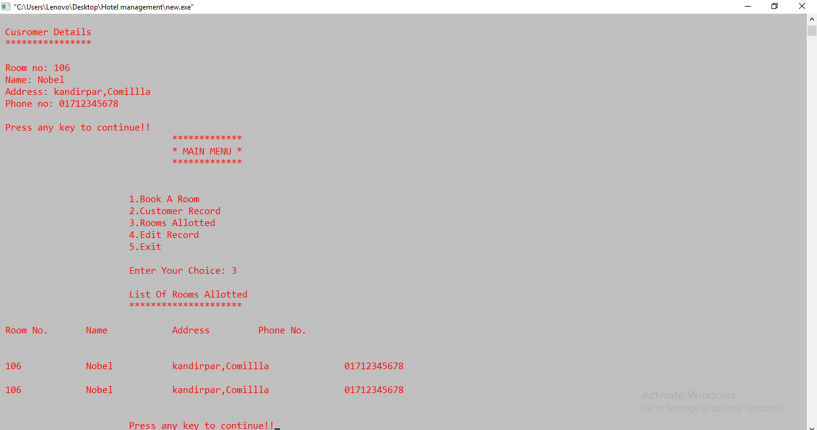
3.FIND WHICH ROOMS ARE ALLOTED

Slide 8
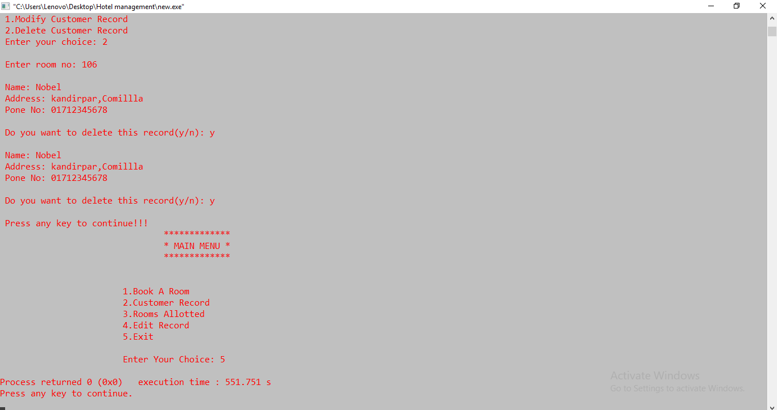
4. EDIT RECORDS

Slide 9
CONCLUSION
Quiet efficient & organazied system for hotel management
Except , there is one drawback , When we try to display the records,it shows same record twice.

Slide 10
Thank You ☺

Slide 11
Presented By:
Alvi Adhikary Niloy
Id : 1105065
level: 2 , Term : 1
dep.of cse

